Slide 1
The Shapes of Molecules
“MOLECULAR GEOMETRY”

Slide 2
VSEPR Theory
Valence Shell Electron Pair Repulsion
Electron Pairs try to get as far away from each other as possible.

Slide 3
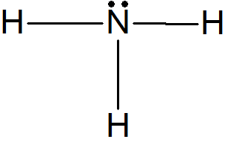
First Some Terminology
Nonbonding Pair of Electrons
Also called “Lone Pair”, “Unshared Pair”
Bonding Pair of Electrons
Also called “Shared Pair”

Slide 4
2 Electron Pairs on Central Atom
Beryllium fluoride
How can we get these electron pairs (balloons) as far apart as possible?
What does the shape look like?
LINEAR
180º Apart
2
0
Shared Pairs
Unshared Pairs
This is a Lewis Structure and a 3D drawing

Slide 5
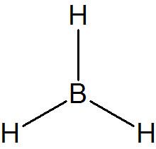
3 Electron Pairs on Central Atom
Boron trihydride
Get three balloons as far apart from each other.
How would you describe the shape?
TRIGONAL PLANAR
120º Apart
3
0
Bonding Pairs
Nonbonding Pairs
This is a 3D drawing of BH₃

Slide 6
What would it look like if?
We had a Double Bond or a Triple Bond?
Treat every bond like it’s a single bond.
Sulfur dioxide
What else new do you notice?

Slide 7
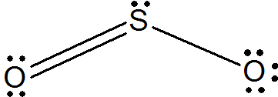
3 Pairs Around Central Atom
The lone pair is still there but we can’t see anything attached to it.
The molecule actually looks like
2
1
Shared Pairs Adjusted
Lone Pair
BENT
Roughly 120º Apart
3D Shape

Slide 8
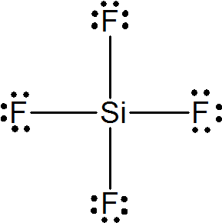
4 Pairs Around Central Atom
Silicon tetrafluoride
Think 3D not 2D…
How might you describe shape?
TETRAHEDRAL
109.5º Apart
Lewis Structure
How do you draw it?
4
0
Shared Pairs
Lone Pairs

Slide 9
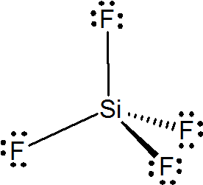
How to Draw a Tetrahedral Shape
Dashed Line Means it’s Going Away From You
Regular Lines Mean it’s in the Plane of the Paper
Wedged Line Means it’s Coming At You.
3D Shape

Slide 10
4 Electron Pairs Around Center
Ammonia
What does it look like?
TRIGONAL PYRAMIDAL
Roughly 109.5º Apart
How do you draw it?
Lewis Structure
3
1
Bonding Pairs
Nonbonding Pair

Slide 11
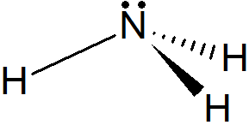
How to Draw Trigonal Pyramidal

Slide 12
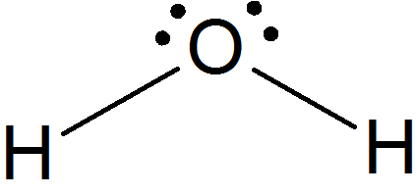
4 Electron Pairs around Center
What does this one look like?
BENT
Roughly 109.5º Apart
How do you draw it?
Water
Lewis Structure
2
2
Shared Pairs
Unshared Pairs
3D Shape

Slide 13
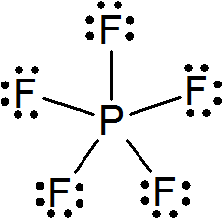
5 Electron Pairs!
Expanded Octets
Phosphorus pentafluoride
What does it look like?
5
0
Shared Pairs
Unshared Pairs
Lewis Structure
TRIGONAL BIPYRAMIDAL
Some are 120º Apart. Others are 90º

Slide 14
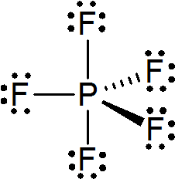
Try to Draw It

Slide 15
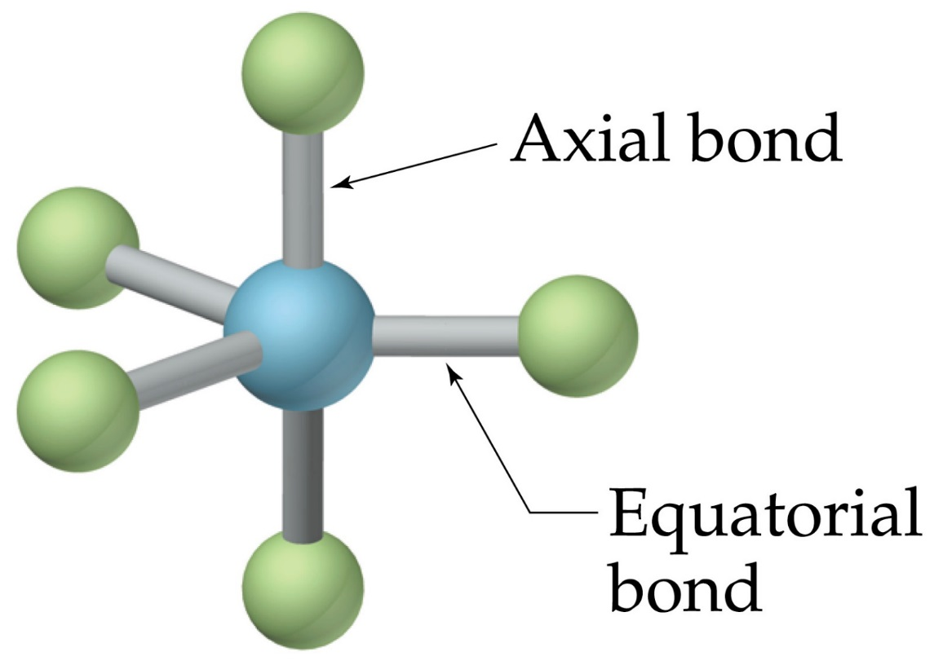
A Little More Terminology

Slide 16
More with 5 pairs
Sulfur tetrafluoride
What does it look like?
Which position does the lone pair go?
Which position would it have the most space?
Lone Pairs always go on equitorial positions in trigonal bipyramidal shapes.
See-Saw
Lewis Structure
4
1
Shared Pairs
Unshared Pairs

Slide 17
3D Shape for See-Saw

Slide 18
More with 5 Pairs
Chlorine trifluoride
What does it look like?
T SHAPED
Lewis Structure
3
2
Shared Pairs
Lone Pairs

Slide 19
Last One with 5 Pairs
Xenon difluoride
What does it look like?
LINEAR
2
3
Shared Pairs
Lone Pairs

Slide 20
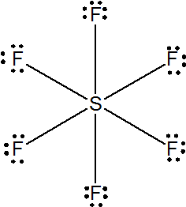
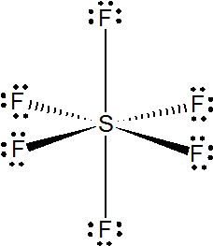
Six Pairs
How do the balloons arrange themselves?
OCTAHEDRAL
Why “octa”?
Sulfur hexafluoride
Lewis Structure
Octahedron
All 90º apart
How do you draw it?
6
0
Shared Pairs
Lone Pairs

Slide 21
More with 6 Pairs
Bromine pentafluoride
What does it look like?
SQUARE PYRAMIDAL
How do you draw it?
5
1
Shared Pairs
Lone Pair
3D Shape

Slide 22
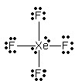
LAST ONE!
Xenon tetrafluoride
The Lone Pairs get as far as possible from each other
What does it look like?
SQUARE PLANAR
All 90º Apart
4
2
Shared Pairs
Lone Pairs

