Slide 1
Chirality

Slide 2
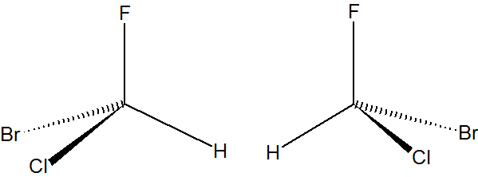
Are These the Same Molecule?

Slide 3
Chirality
Chiral molecule – a molecule whose mirror image is not superimposable on the original molecule
Stereoisomers
Enantiomers
Will have “optical activity”
Will behave differently in biological systems

Slide 4
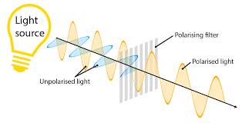
Optical Activity
Polarized light – light where all the electromagnetic oscillations are oriented parallel to each other

Slide 5
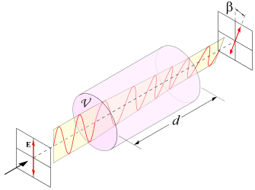
Optical Activity
Chiral molecules rotate polarized light
Levorotatory
Rotate to the left
Dextrorotatory
Rotate to the right
Newer naming system uses R and S.

Slide 6
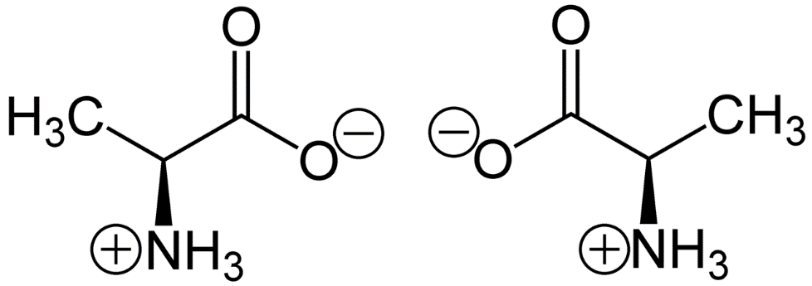
Biological Molecules
Naturally occurring sugars are D-sugars
Naturally occurring amino acids are L-amino acids
L-alanine
D-alanine

Slide 7
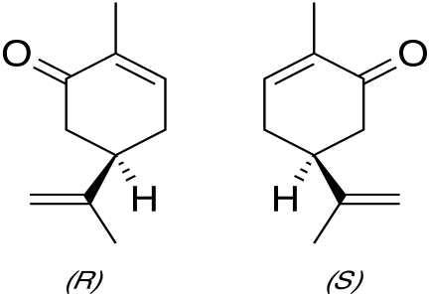
Carvone
L-carvone smells like spearmint
D-carvone smells like caraway seeds
L-carvone
D-carvone

Slide 8
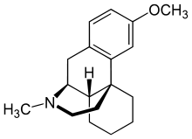
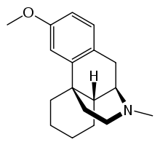
Dextromethorphan and Levomethorphan
Dextromethorphan is a cough suppressant
Levomethorphan is a opioid.
Dextromethorphan
Levomethorphan

Slide 9
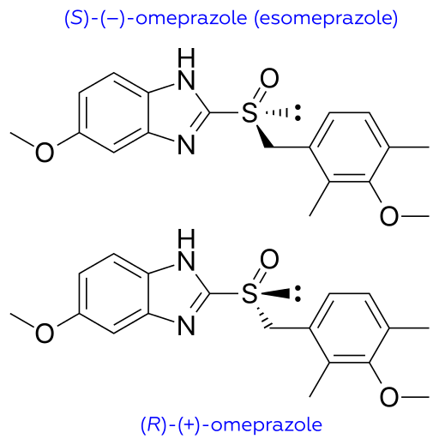
Omeprazole
Prilosec
Omeprazole
Racemic mixture
Both enantiomers
Nexium
Esomeprazole
Enantio-pure S isomer

Slide 10
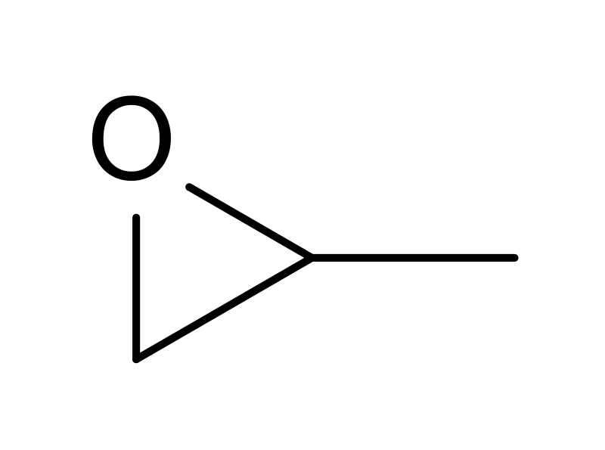
Propylene Oxide
Announced recently to have been found in space
First chiral molecule detected in space

Slide 11
How to Tell Its Chiral?
Cheating Organic Chemistry Way
If a carbon has 4 different things on it, then its chiral
Doesn’t always work
Isn’t applicable past carbon
Right Way
If a molecule has no S operations, then it is chiral
S operations include σ and I
So really just find the point group…

