Slide 1
Lewis Structures
Crash Course

Slide 2
Covalent Bonding
Sharing electrons between atoms
One line = SINGLE BOND = 2 electrons
Two lines = DOUBLE BOND = 4 electrons
Three lines = TRIPLE BOND = 6 electrons

Slide 3
Multiple Covalent Bonds

Slide 4
Octet Rule
Atoms tend to share electrons to get an “octet”
Octet – 8 electrons in the outer (valence) shell
“Full” outer shell
Noble gas configuration

Slide 5
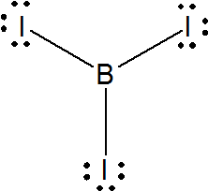
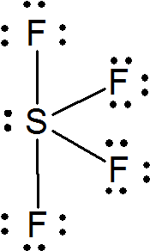
Octet Exceptions
Hydrogen
sortof
Deficient Atoms
B, Be, Al
Octet Expansions
Period 3+ and Groups 15-18

