Slide 1
Organic Chemistry
Crash Course

Slide 2
Basics
Organic Chemistry - the chemistry of most carbon containing compounds
In stable compounds, you should expect:
Carbon to form 4 bonds
Nitrogen to form 3 bonds (4 if formally positive)
Oxygen to form 2 bonds (1 if formally negative)
Hydrogen to form 1 bond
Carbon atoms are usually bonded to each other in a chain with things hanging off

Slide 3
Organic Shorthand
Drawing all those hydrogens gets tedious
Condense them
Use a line notation
Each red dot represents a carbon
It is understood that each carbon has an octet filled out with hydrogen unless otherwise noted.
All other atoms have their octets filled with lone pairs unless otherwise noted.

Slide 4
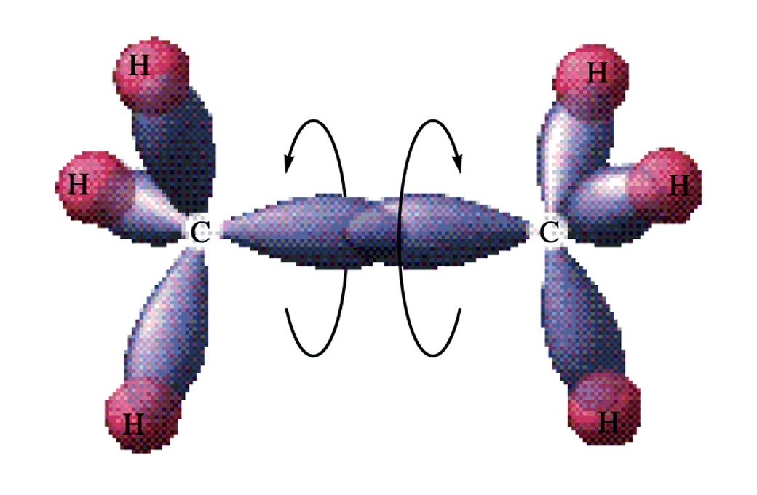
Single Bond Rotation
Single bonds rotate freely around.

Slide 5
Practice

Slide 6
Practice

Slide 7
Practice

Slide 8
Practice

Slide 9
Cis-Trans Isomers
Arrangement around the double bond
With single bonds there is free rotation about the bond
A double bond does not have free rotation due to its orbital structure

Slide 10
Cis-Trans Isomerism
If the chain is on the same side of the double bond, it is called cis-
If the chain is on the opposite side of the double bond, it is called trans-

Slide 11
Ozone
Consider the Lewis Structure for Ozone, O₃
Describe the length of the two bonds

Slide 12
Resonance
You could draw two structures of ozone
Neither structure is satisfactory
The real structure is somewhere in between the two structures
This is known as resonance
Mostly occurs with different positions of double bonds.

Slide 13
Resonance
The double bond is not alternating back and forth.
It is a blend of the two structures
The actual structure has a bond length that is in between a single and double bond length.
The electrons are delocalized.
Spread out over the whole molecule.

Slide 14
Nitrate Ion

Slide 15
Benzene
C₆H₆

Slide 16
Using Models
C = black/gray
Tetrahedral C = black
Trigonal planar C = gray
H = white
O = red
N = blue
Shape is just linking the VSEPR shapes.

Slide 17
Practice

