Slide 1
Point Groups

Slide 2
Point Groups
Molecules can be grouped together based on common symmetry operations
Defined based on mathematical group theory
The group defines all the possible symmetry operations

Slide 3
Examples
C₂
C_{4v}
D_{3h}
D_{6d}
T_{d}
C_{s}
O_{h}
I_{h}

Slide 4
Anatomy of a Point Group
C₂
C_{4v}
D_{3h}
D_{6d}
T_{d}
C_{s}
O_{h}
I_{h}
First Letter
C – Cylical
one principal axis (or something simple)
D – Dihedral
one principal axis, C₂’s perpendicular to axis
T – Tetrahedral
O – Octahedral
I – Icosahedral
S – Improper Rotation Groups

Slide 5
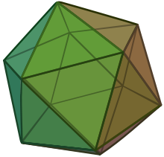
Icosahedron

Slide 6
Anatomy of a Point Group
C₂
C_{4v}
D_{3h}
D_{6d}
T_{d}
C_{s}
O_{h}
I_{h}
Numeric subscript
Tells the order of the principal axis of rotation
Letter subscript
Tells about other operations (mostly mirror planes)
h = contains a horizontal mirror plane
d = contains dihedral mirror planes
v = contains vertical mirror planes

Slide 7
Low Symmetry Point Groups
C₁ =
C_{s} =
C_{i} =
E
E, σ
E, i

Slide 8
Cyclical Point Groups
C_{n} =
C_{nv} =
C_{nh} =
E, C_{n}
E, C_{n}, nσ_{v}
If n > 3 and even then some σ_{v} are better labeled σ_{d}
E, C_{n}, σ_{h}, S_{n}, (i if n = even)

Slide 9
Dihedral Point Groups
D_{n} =
D_{nh} =
D_{nd} =
E, C_{n}, nC₂ ⊥ C_{n}
E, C_{n}, nC₂ ⊥ C_{n}, σ_{h}, nσ_{v}, S_{n}, (i if n = even)
If n > 3 and even then some σ_{v} are better labeled σ_{d}
E, C_{n}, nC₂ ⊥ C_{n}, nσ_{d}, S_{2n}, (i if n = odd)

Slide 10
Improper Rotation Group
S_{2n} =
E, C_{n}, S_{2n}
Only for S_{4,} S_{6,} S₈
If S₆, then also has i

Slide 11
High Symmetry Groups
T_{d} =
O_{h} =
I_{h} =
E, 4C₃, 3C₂, 3S₄, 6σ_{d}
E, 3C₄, 4C₃, 6C₂, i, 3S₄, 4S₆, 3σ_{h}, 6σ_{d}
E, 6C₅, 10C₃, 15C₂, i, 6S₁₀, 10S₆, 15σ

Slide 12
Examples
Give all the symmetry operations found in water.

Slide 13
Examples
Give all the symmetry operations in hypochlorous acid.

Slide 14
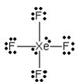
Examples
Find all the symmetry operations in xenon tetrafluoride.

Slide 15
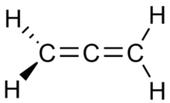
Examples
Find all the symmetry operations in allene

Slide 16
Examples
Find all the symmetry operations in hydrochloric acid.

Slide 17
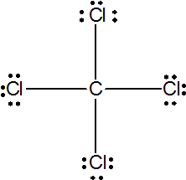
Examples
Give all the symmetry operations in a carbon tetrachloride molecule.

Slide 18
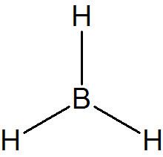
Examples
Give all the symmetry operations in a borane molecule.

