Slide 1
Symmetry Operations

Slide 2
Symmetry Operations
Symmetry Operation – a permutation of atoms that leads to an arrangement of the atoms that is indistinguishable from the initial arrangement.
Five Symmetry Operations
Identity – E
Proper Rotation – C_{n}
Mirror Plane – σ
Inversion – i
Improper Rotation - S_{n}

Slide 3
Identity - E
Do Nothing
Necessary from a group theory standpoint

Slide 4
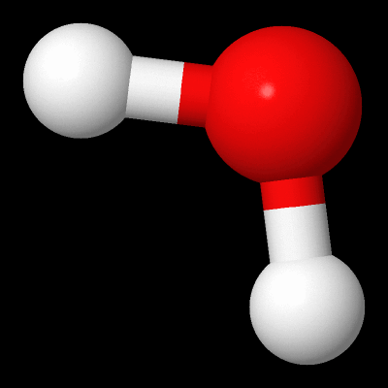
Proper Rotation - C_{n}
Proper rotation – C_{n} – a rotation about an axis
Uses notation C_{n}^{m}
n gives the degrees of rotation, 360°/n
m gives the number of turns
omitted if m = 1
C₄² = C₂
Highest order rotation axis in a molecule is the principal axis.
Often there are C₂ perpendicular to the principal axis

Slide 5
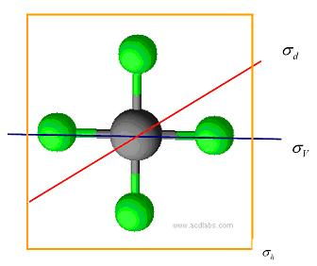
Mirror Plane - σ
Mirror plane – σ – a reflection of the atoms through a plane
Three types
σ_{h} – horizontal mirror plane
σ_{v} – vertical mirror plane
σ_{d} – dihedral mirror plane

Slide 6
Mirror Plane - σ
σ_{h} – horizontal mirror plane
perpendicular to principal axis
σ_{v} – vertical mirror plane
principal axis is contained in this plane
σ_{d} – dihedral mirror plane
a special case of σ_{v} where the plane bisects the space between two equivalent C₂ axes

Slide 7
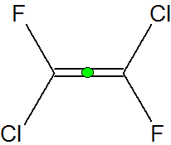
Inversion – i
Inversion – i – reflection about a center point
Inversion center may or may not be on an atom.

Slide 8
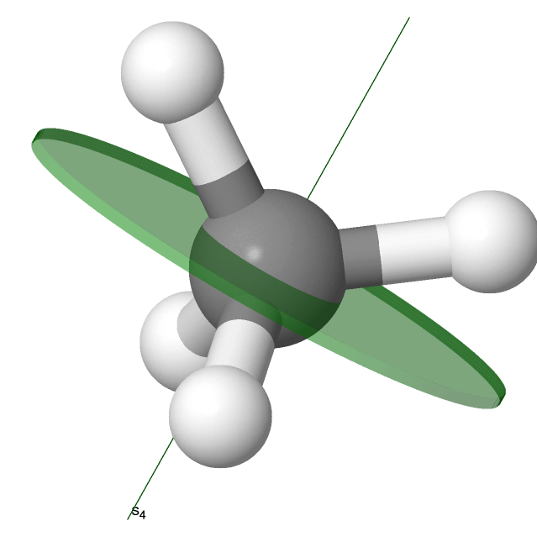
Improper Rotation - S_{n}
Improper rotation – S_{n} – a rotation about an axis followed by a reflection through the plane perpendicular to the axis.
Uses same S_{n}^{m} notation as proper rotations.

Slide 9
Examples
Give all the symmetry operations found in water.

Slide 10
Examples
Give all the symmetry operations in hypochlorous acid.

Slide 11
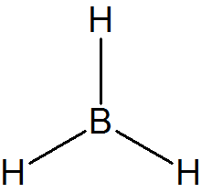
Examples
Give all the symmetry operations in a borane molecule.

Slide 12
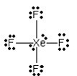
Examples
Find all the symmetry operations in xenon tetrafluoride.

Slide 13
Examples
Find all the symmetry operations in hydrochloric acid.

Slide 14
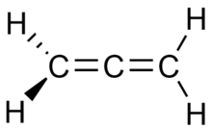
Examples
Find all the symmetry operations in allene

Slide 15
Equivalent Operations
C₂² =
σ² =
S₁ =
S₂ =
S₄² =
S₄⁴ =
S₃³ =
S₃⁶ =
E
E
σ
i
C₂
E
σ
E

